Slide 1
A students presentation

Slide 2
Directions for Students
Students were assigned to create a PowerPoint to teach the class using the internet and the following information. Students could use the internet and any text resources.
Cereal Crops
1. What are cereal crops?
2. Create PowerPoint which must included
a. The growth stages of the crops
b. What happens at each growth stage
c. Critical management factors at each growth stage
3. Helpful websites
http://www.spectrumanalytic.com/support/library/pdf/guide_to_determining_growth_stages_of_wheat.pdf
http://wheatdoctor.cimmyt.org/index.php?option=com_content&task=view&id=9&Itemid=39&lang=en
Understand the Barley Plant parts by looking at the pictures be ready to be quizzed over them
http://www.extension.umn.edu/distribution/cropsystems/DC2548.html

Slide 3
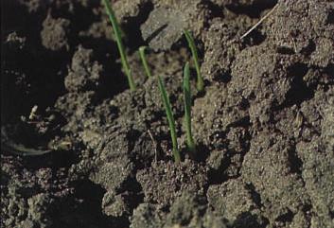
Emergence until the onset of tillering

Slide 4
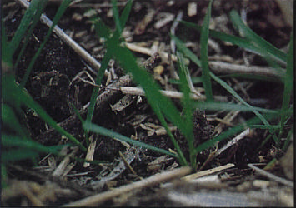
Begin of Tillering

Slide 5
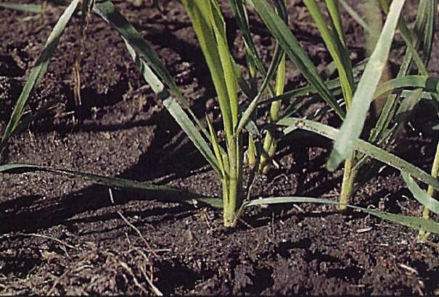
Tillers Formed

Slide 6
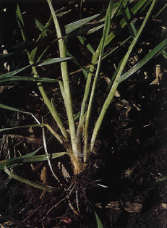
Beginning of Erect growth, leaf sheaths lengthen

Slide 7
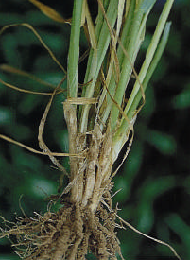
Leaf sheaths strongly erect. All meaningful tiller development has ceased

Slide 8
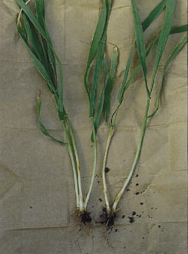
First node visible.

Slide 9
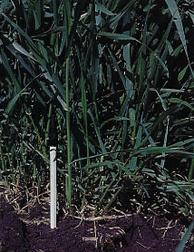
Second node and next to last leaf visible.

Slide 10
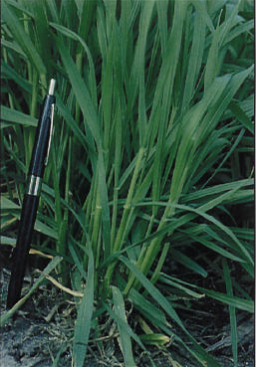
Flag leaf visible.

Slide 11
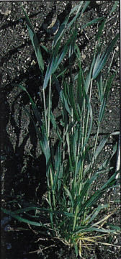
Ligule of flag leaf visible.

Slide 12
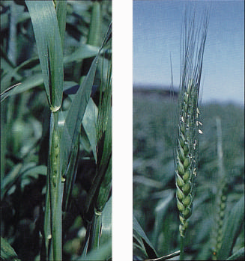
Boot stage

Slide 13
Ripening
11.1 milky ripe
11.2 mealy ripe
11.3 kernel hard
11.4 harvest ready

