Slide 1
Student Work
In groups of two students were assigned to create PowerPoint's and teach the class for the introduction to Anatomy chapter in their College Level Working With Animals Class.
I have combined a few of the bodily Systems into one PowerPoint to reflect students work.

Slide 2
Reproductive System
By: Chelsea and Mackenzie

Slide 3
Reproductive System
Animal reproduction always involves some type of cell division. Whether the cells are fertilized or unfertilized, depends on the species, anatomy and psychology of the animal.

Slide 4
Pig
-Penis, scrotum, urogenital opening
-seminal vesicle, testis, ureter, urinary bladder, vas deferens
-bulbourethral gland, spermatic cord, testis, urethra, urinary bladder, vas deferens
-Path of urine flow
116 days pregnant
99 % of pigs are AI

Slide 5
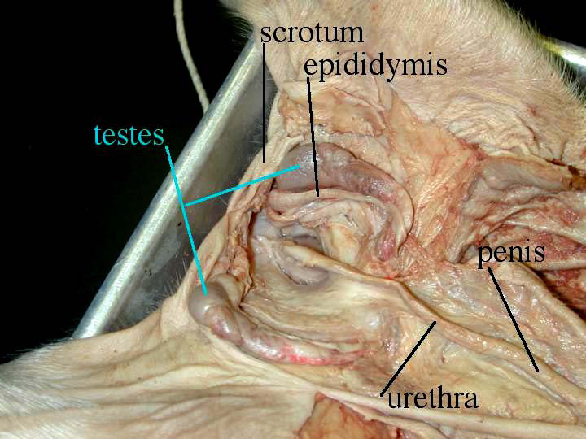

Slide 6
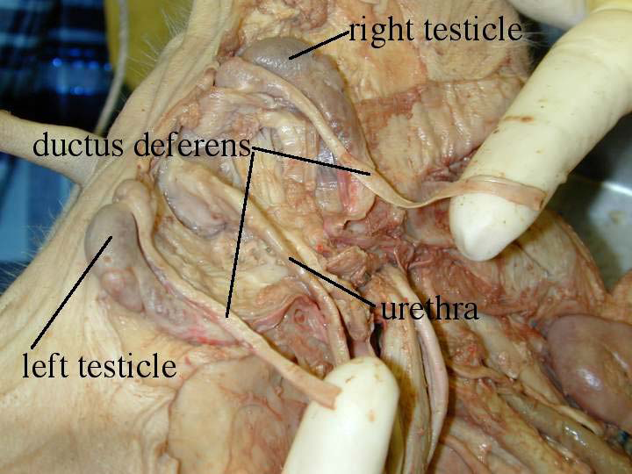

Slide 7
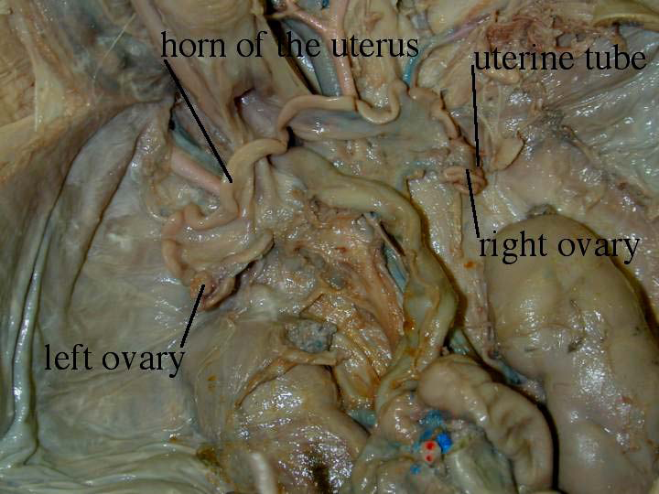

Slide 8
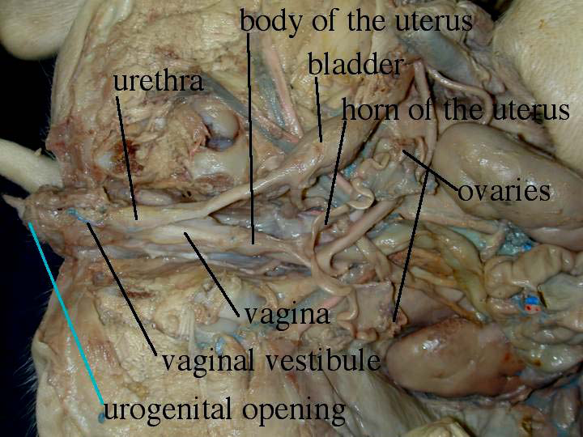

Slide 9
Cow
Vulva
Vagina
Cervix
Uterus
Uterine Horns
Oviduct
Infundibulum
Ovary
Bladder
Blind Pouch
Clitoris

Slide 10
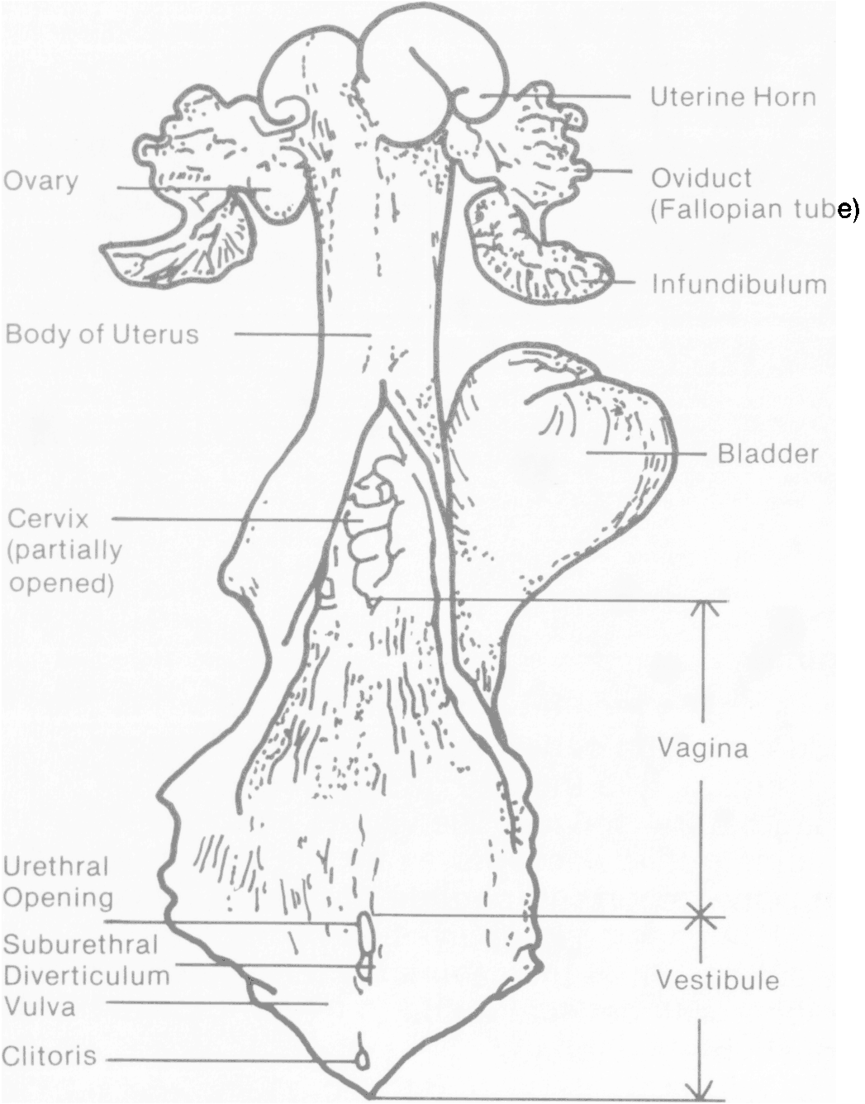

Slide 11
Horse
Females-- gestation, birth and lactation
Stallion-- External glands: Testes, penis
Internal glands: vesicular gland
Prostate gland
Bulb urethral gland
These are used to contribute to the fluid to equine semen for ejaculation.

Slide 12
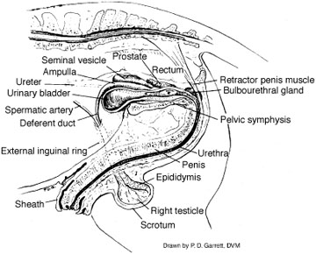

Slide 13
Poultry
Ovary
Infundibulum
Magnum
Isthmus
Uterus
Vagina
Cloaca

Slide 14
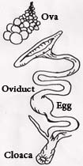
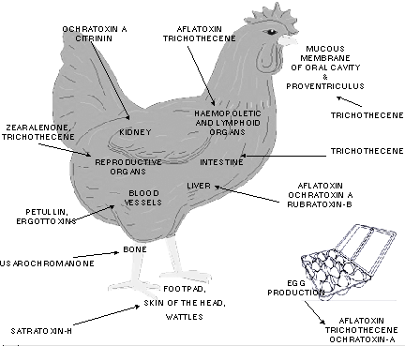

Slide 15
The Muscular System
Jordan & Adam

Slide 16
Purpose
Provides movement in conjunction with the skeletal system.
Important in life support.

Slide 17
Classifications
Voluntary: Muscles that are under the control of the creature.
Involuntary: Muscle that is not controlled by the creature.

Slide 18
Types of muscles
Smooth
Cardiac
Skeletal

Slide 19
Smooth
Involuntary
Found in the walls of internal organs and in blood vessels.
Spindle shaped

Slide 20
Cardiac
Muscles that form a network to not up the heart.
Involuntary
Only found in heart.

Slide 21
Skeletal
Both voluntary and involuntary
Attaches and moves the bones in body.
This is the majority of the muscle tissue in the body.

Slide 22
Muscles in Animals
Movement of the hocks in animals is accomplished by flexors and extensors.

Slide 23
conclusion
This system is responsible for movement and protection of internal organs.

